Slide 1

TIME AND SPACE COMPLEXITY
LESSON 14
CFGDEGREE → FULL-STACK STREAM

Slide 2

AGENDA
01 Complexity Analysis
02 Big O Notation
03 Practice and coding

Slide 3


Why are we learning about this?
What's the purpose?
Many interview processes have unreasonable expectations - you’re expected to solve difficult technical problems that you would never do in the actual job (who needs to invert a binary tree? No one!).
Since it’s common to be asked these areas in technical interviews (regardless of the role), we cover these topics anyway. Regardless of where you work, you’ll likely need to know these areas anyway (e.g. switching jobs and needing to interview). This is why we’ll cover the topics on the right-hand side of the image.
Note: You should also ideally learn /revise OOP (important) and networking (TCP/IP, packets, etc) - we just didn’t have as much time to delve into them but they’re just as important ! (+ not enough image space to fit them in)

Slide 4
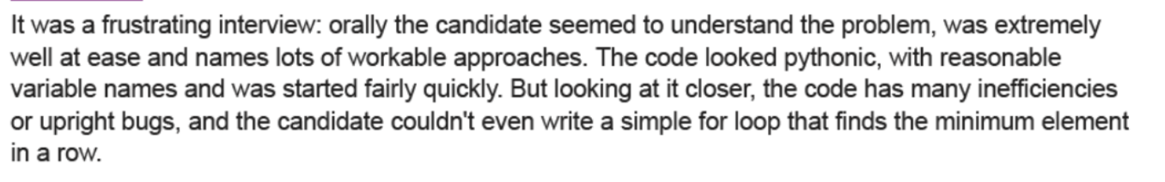
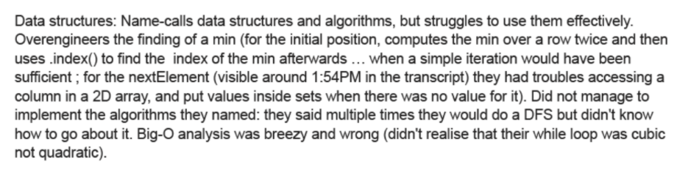
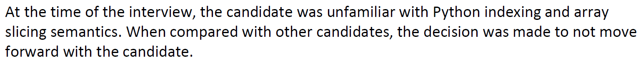

Rejection is very normal (Pt. 1)
And the content we’ll cover is very difficult. Struggling is normal - do not worry!
The content and this industry in general will humble you (see right).
It’s important to realise that the content we’ll be covering today (and for the next few sessions) is incredibly hard - struggling is absolutely normal and completely fine. They’re deployed in technical interviews for a reason.
It’s also important to keep in mind that rejection is very normal - it is not a determinant of your developer talent. You’ll bomb some interviews (see right) and ace others / get offers.
# SOURCE: (SLIDE CREATOR’S) MULTIPLE BIG TECH FEEDBACK (OBTAINED VIA GDPR - IT WAS NOT MEANT TO BE PUBLIC TBF)

Slide 5
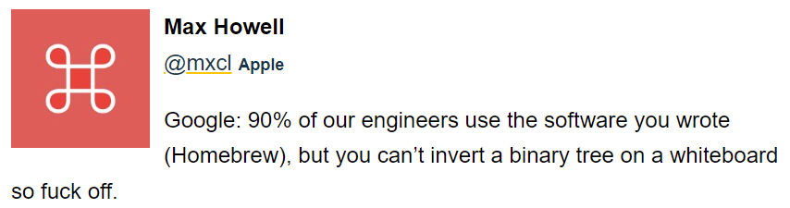
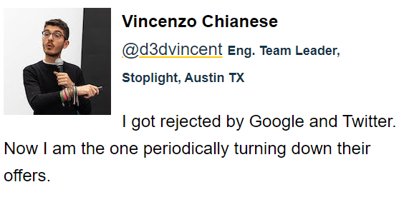
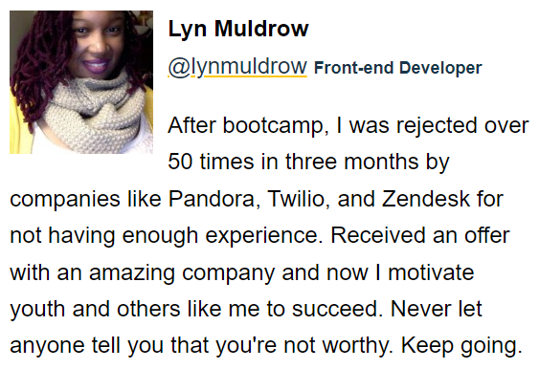
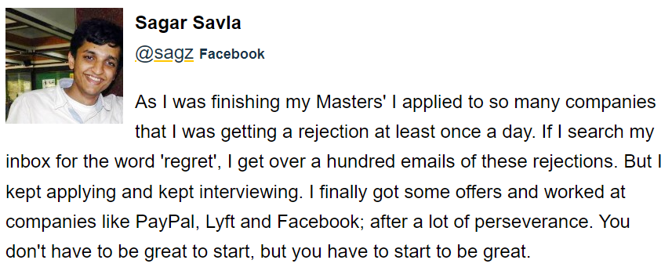
Rejection is very normal (Pt. 2)
And the content we’ll cover is very difficult. Struggling is normal - do not worry!
Regardless of how well you learn these topics, you may still get rejected anyway! Maybe the interviewer is having a bad day, maybe you just panicked, maybe it was a bad day for you, maybe you weren’t familiar with the code-solving technique.
As a result, please remember that rejection is perfectly normal + struggling on these topics is fully normal. These are some of the hardest areas in CS for a reason - don’t stop and keep pushing forward!
These areas will be useful both for your day-to-day, as well as your career.
# SOURCE: REJECTED.US

Slide 6

With that in mind…
Let’s start!
(One more thing)
We’ll be going back to Python again for the next few sessions - this is because the concepts we learn are universal to any language - they’re sheer CS theory (instead of say, being JavaScript specific).
Python is used as the lack of syntax requirements makes it easy to learn these topics - moreover, it’s an exercise on practicing CS theory across multiple languages (e.g. so you can understand how an Array or Time Complexity or Hashing works fundamentally regardless of the language you implement it in).

Slide 7

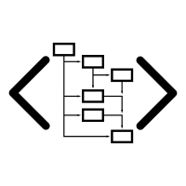
COMPLEXITY ANALYSIS
INTRODUCTION
HIGH LEVEL OVERVIEW
Notes:
Using AutoDraw https://www.autodraw.com/ let’s walk about the concept of Complexity Analysis.
Please see the example guide video: complexity.mp4

Slide 8
COMPLEXITY ANALYSIS
Complexity analysis is effectively used to determine how ‘good’ an algorithm is and whether it’s “better” than another one.
The process of determining how efficient an algorithm is. Complexity analysis usually involves finding both the time complexity and the space complexity of an algorithm.”

Slide 9
TIME SPACE COMPLEXITY
Time and space complexities are central concepts in the field of algorithms and in coding interviews.
Time and space complexity is expressed using “Big O notation”.
Time complexity - a measure of how fast an algorithm runs.
Space complexity - a measure of how much auxiliary memory an algorithm takes up.

Slide 10
BIG O NOTATION
INTRODUCTION
HIGH LEVEL OVERVIEW
Notes:
Using AutoDraw https://www.autodraw.com/ let’s walk about the concept of Complexity Analysis.
Please see the example guide video: bigOnotation.mp4

Slide 11
BIG O NOTATION
Constant: O(1)
Logarithmic: O(log(n))
Linear: O(n)
Log-linear: O(nlog(n))
Quadratic: O(n²)
Cubic: O(n³)
Exponential: O(2^{n})
Factorial: O(n!)
The notation is used to describe the time complexity and space complexity of algorithms.
Variables used in Big O notation denote the sizes of inputs to algorithms.
For example O(n + m) might be the time complexity of an algorithm that traverses through an array of length n and through a string of length m.
Notes:
Bullet points on the right hand side are examples of common complexities and their Big O notations, ordered from fastest to slowest.

Slide 12
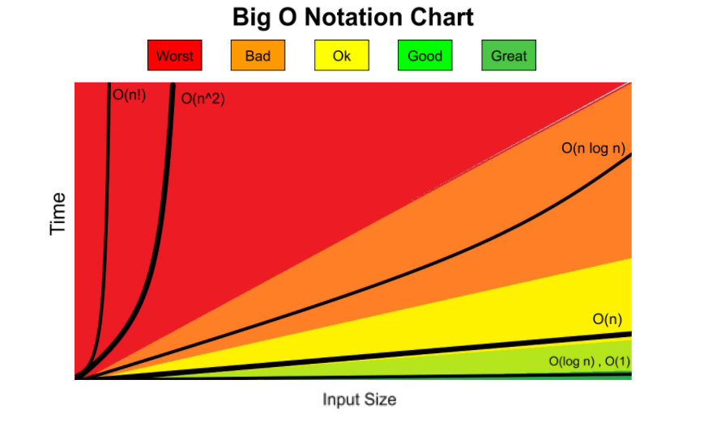
BIG O NOTATION

Slide 13

DEMO &
EXERCISES
ALGORITHMS
EXERCISES & PRACTICE

Slide 14
THANK YOU!

